Slide 1
N. Rizk
COSC 3337 : Data Science I
College of Natural and Applied Sciences
Department of Computer Science
University of Houston

Slide 2
What is a heatmap?
The heatmap is a way of representing the data in a 2-dimensional form. The data values are represented as colors in the graph. The goal of the heatmap is to provide a colored visual summary of information.
(rows features such as exam1, exam2…)
(column instances such as student1, student2)

Slide 3
Create a heatmap
To create a heatmap in Python, we can use the seaborn library. The seaborn library is built on top of Matplotlib. Seaborn library provides a high-level data visualization interface where we can draw our matrix.

Slide 4
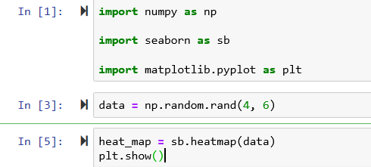
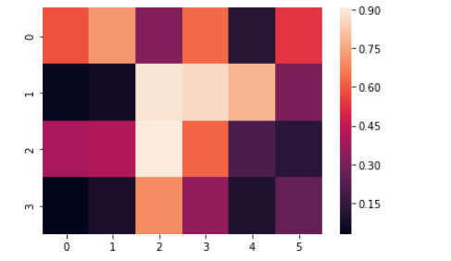

Slide 5
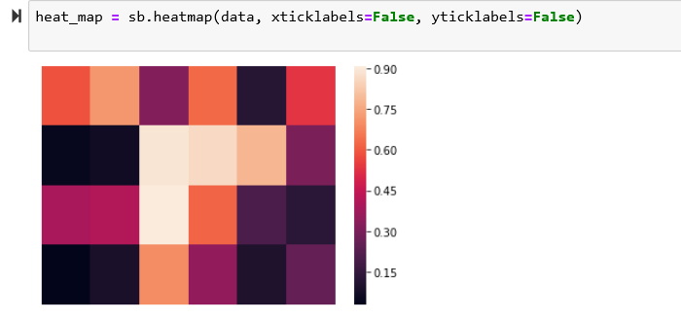
Remove heatmap x tick labels

Slide 6
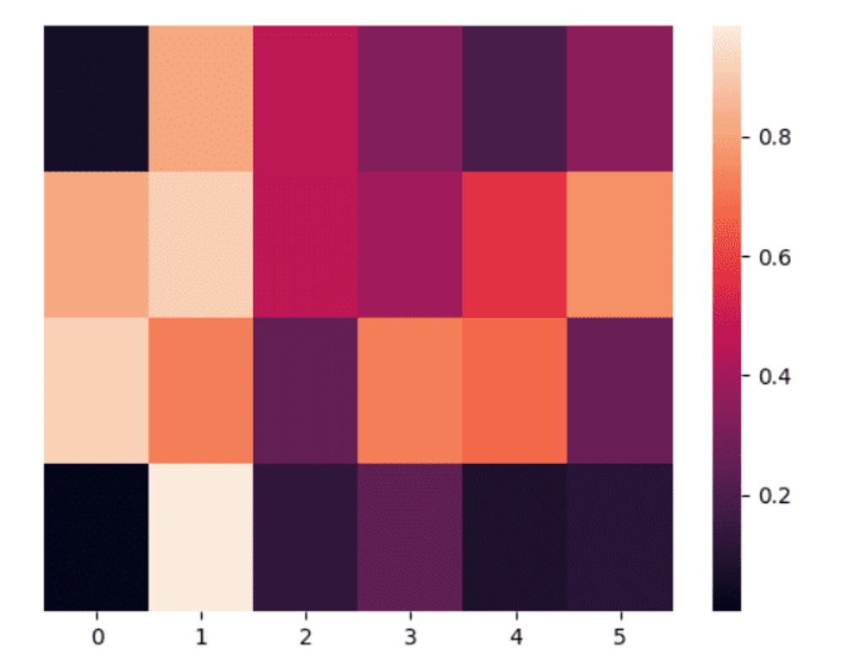
Remove heatmap y tick labels heat_map = sb.heatmap(data, yticklabels=False)

Slide 7
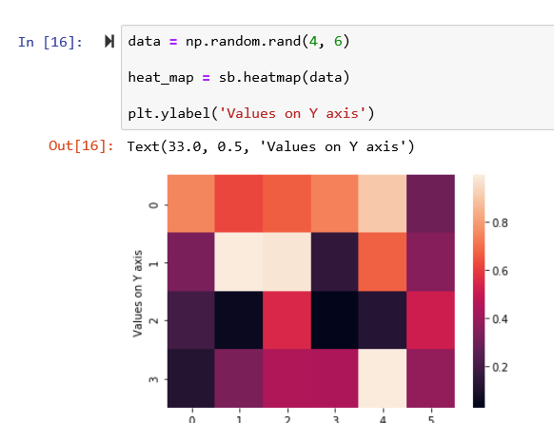

Slide 8
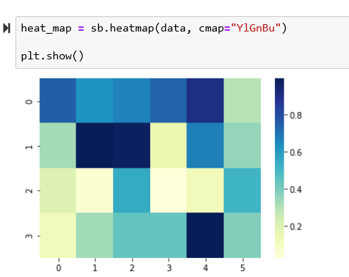
Changing heatmap color

Slide 9
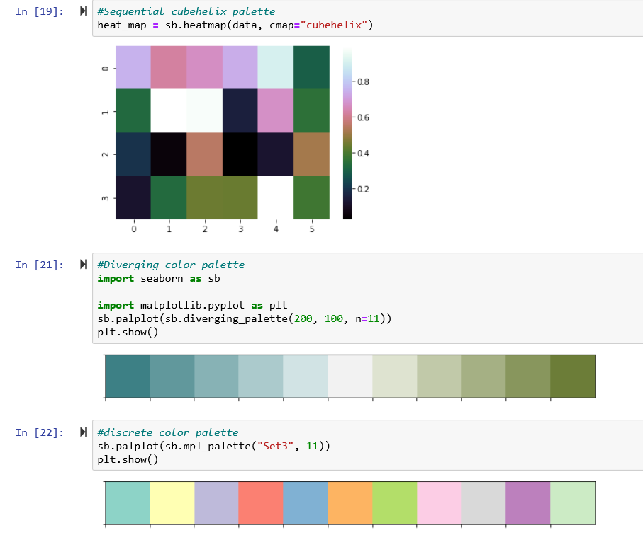
11 means number of colors

Slide 10
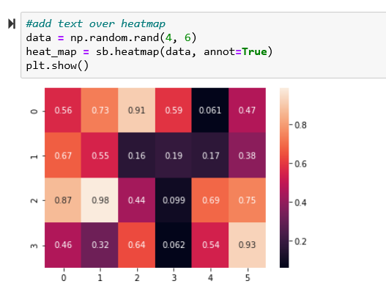

Slide 11
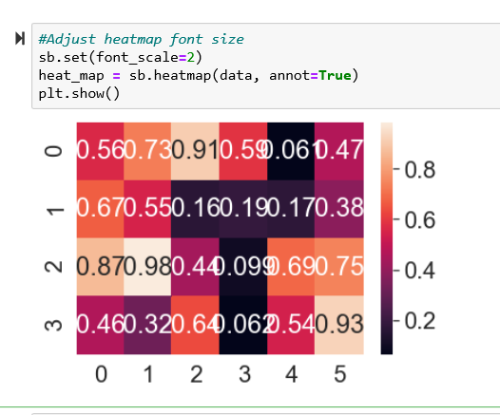

Slide 12
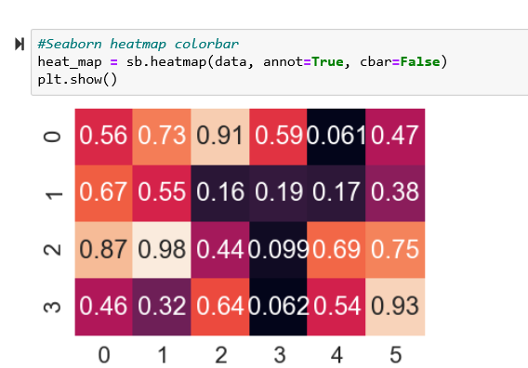

Slide 13
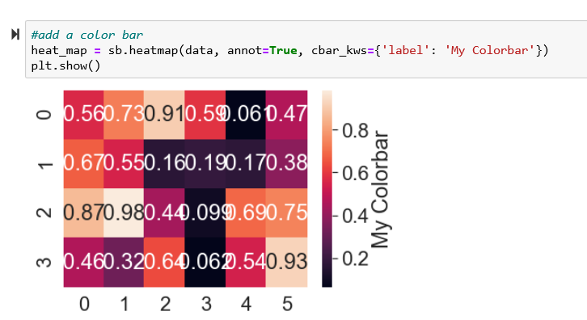

Slide 14
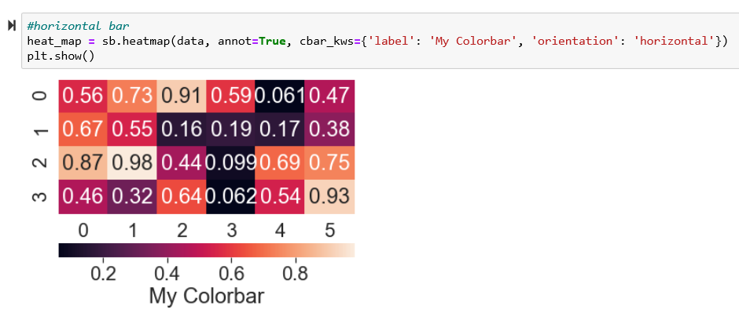

Slide 15
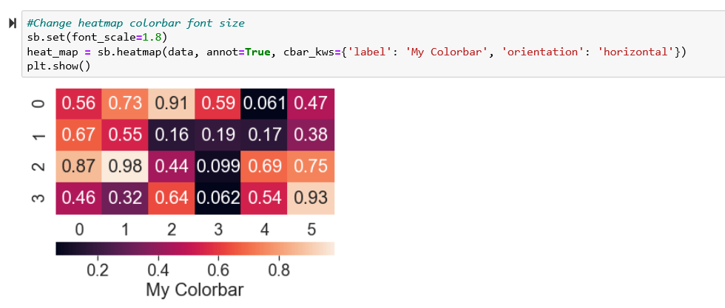

Slide 16
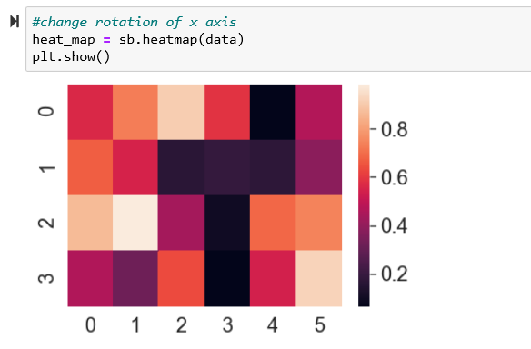

Slide 17
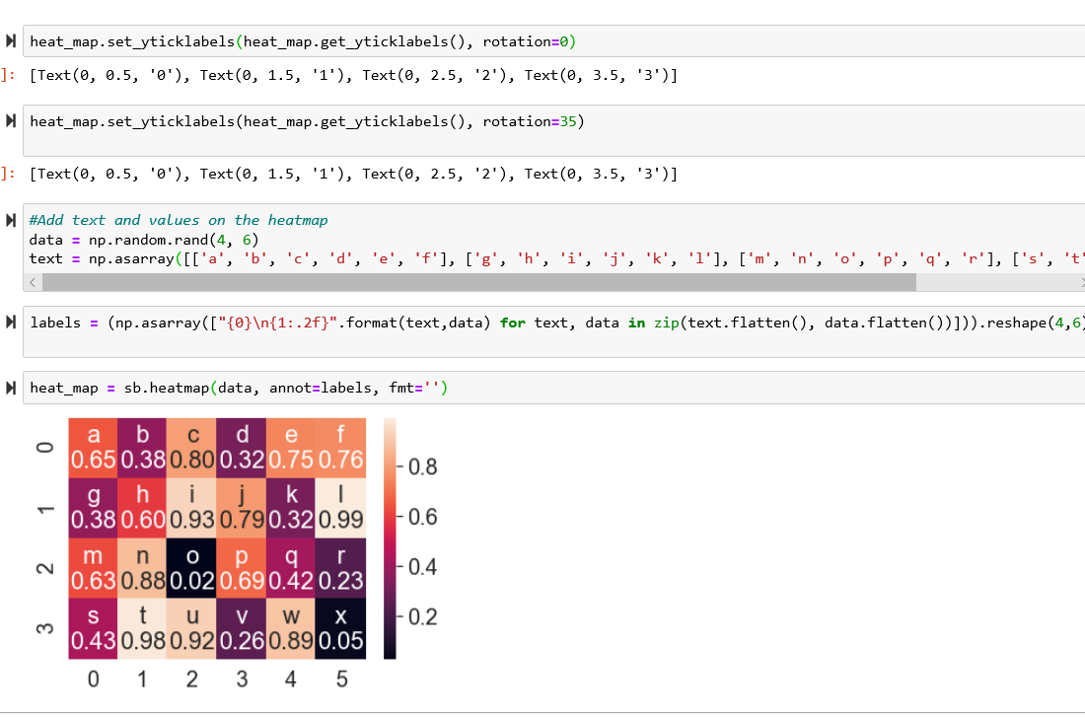

Slide 18
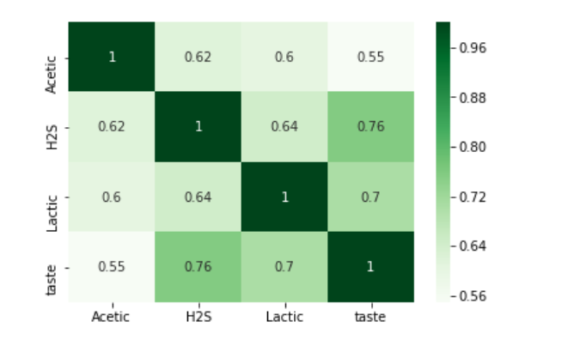
Each square shows the correlation between the variables on each axis.
Correlation ranges from -1 to +1. Values closer to zero means there is no linear trend between the two variables. The close to 1 the correlation is the more positively correlated they are;
that is as one increases so does the other and the closer to 1 the stronger this relationship is.
A correlation closer to -1 is similar, but instead of both increasing one variable will decrease as the other increases.
The diagonals are all 1/dark green because those squares are correlating each variable to itself (so it's a perfect correlation).
For the rest the larger the number and darker the color the higher the correlation between the two variables.
The plot is also symmetrical about the diagonal since the same two variables are being paired together in those squares.
We use HeatMap to use Dendrogram
When you can use HeatMap Vs ScatterPlot?

Slide 19
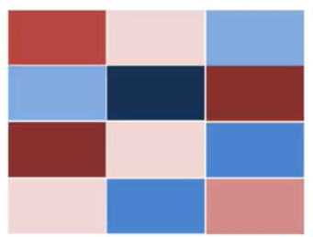
Hierarchical clustering reorder rows (features) and columns (samples )
based on their similarities
Students
1 2 3
1
2
3
4
Exams
How to reorder exams based on the similarity?

Slide 20
Exam1 and Exam 3 are similar (highly expressed for student 1 and
lowly expressed for student 3
Students
1 2 3
1
2
3
4
Exams

Slide 21
Exam2 and Exam 4 are similar
Exam3 and ………………
Exam4 and ………………………..
Students
1 2 3
1
2
3
4
Exams

Slide 22
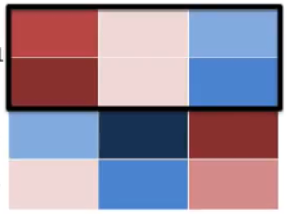
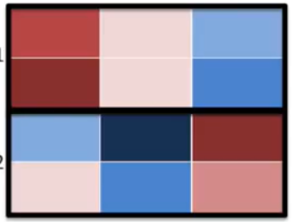
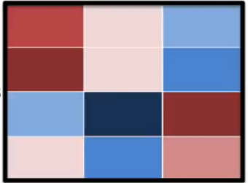
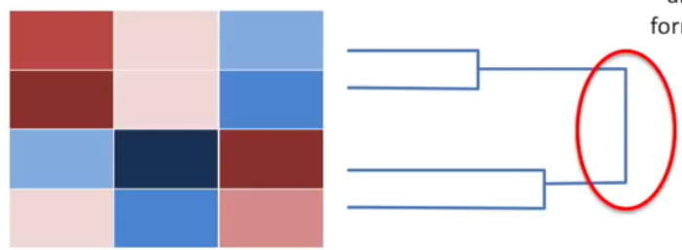
Forming Clusters
1
3
2
4
Arrogrative Clustering

Slide 23
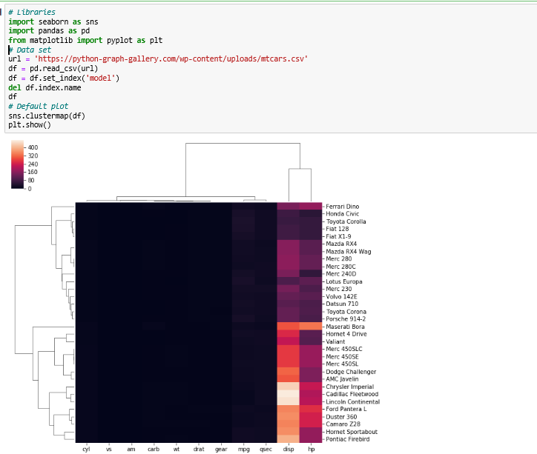
Dendrogram with heat map

Slide 24
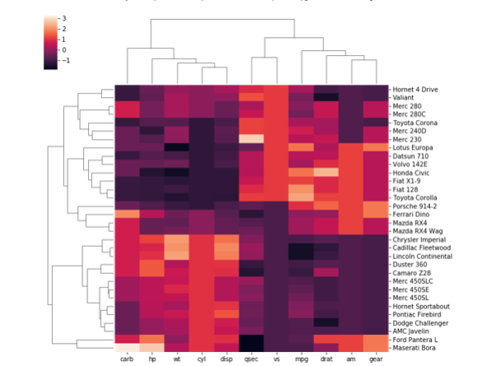
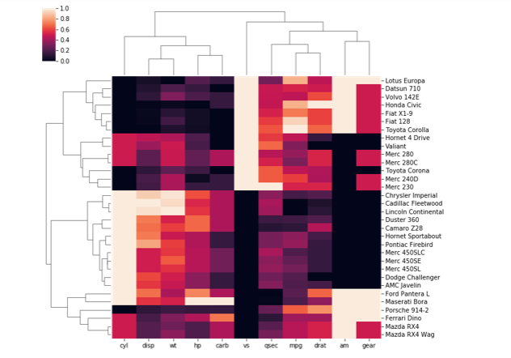
# Standardize: sns.clustermap(df, standard_scale=1)
# Normalize sns.clustermap(df, z_score=1)

Slide 25
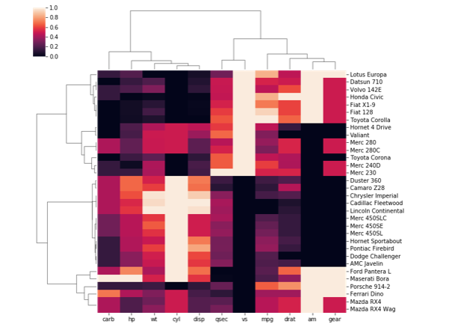
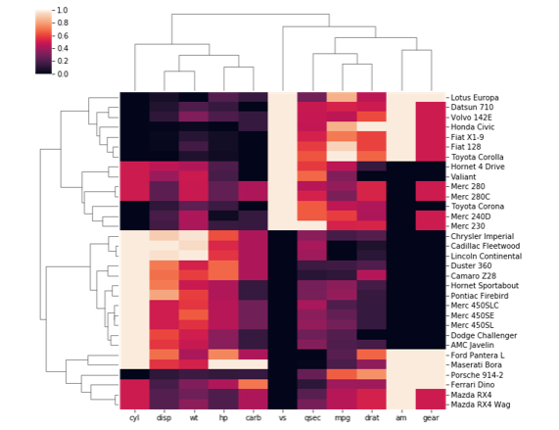
correlation and euclidean distance?
sns.clustermap(df, metric="correlation", standard_scale=1)
sns.clustermap(df, metric="euclidean", standard_scale=1)
VERY USEFULL

Slide 26
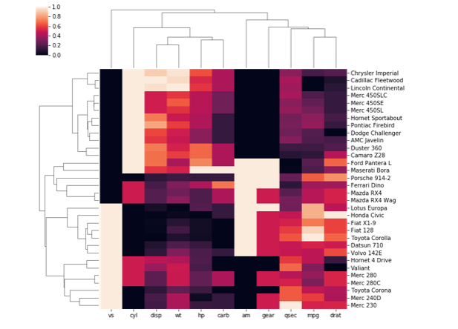
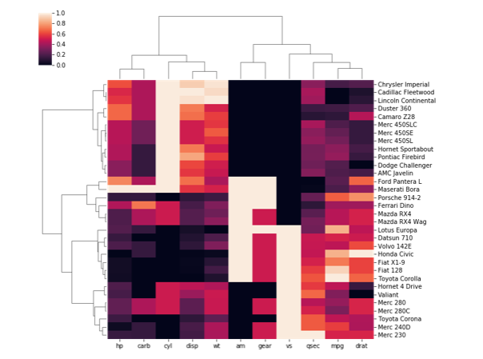
sns.clustermap(df, metric="euclidean", standard_scale=1, method="single")
sns.clustermap(df, metric="euclidean", standard_scale=1, method="ward“)
AGGRORATIVE CLUSTERING HEATMAP

Slide 27
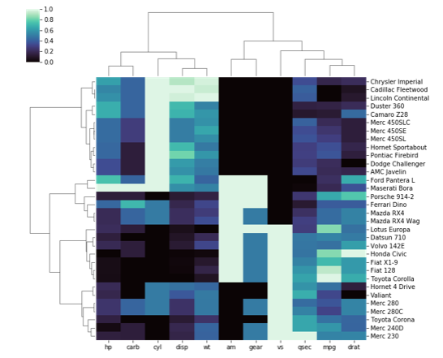
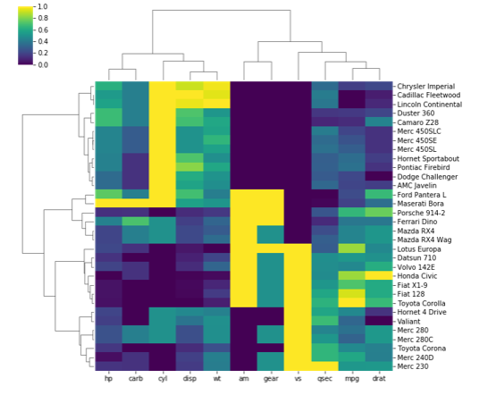
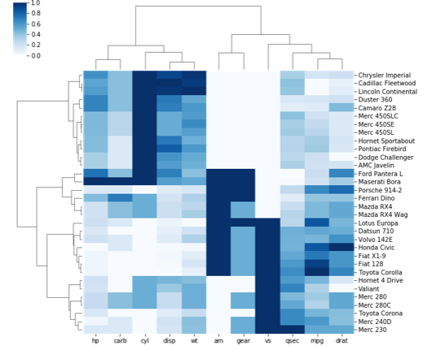
sns.clustermap(df, metric="euclidean", standard_scale=1, method="ward", cmap="mako") “viridis“ “Blues"

Slide 28
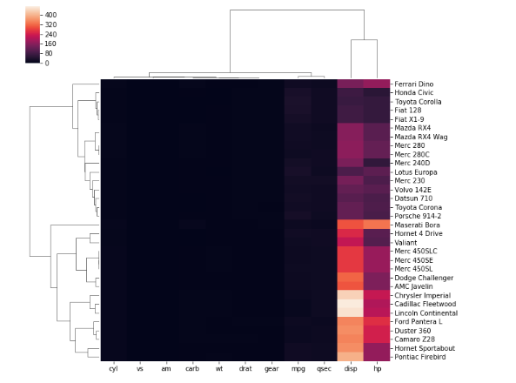
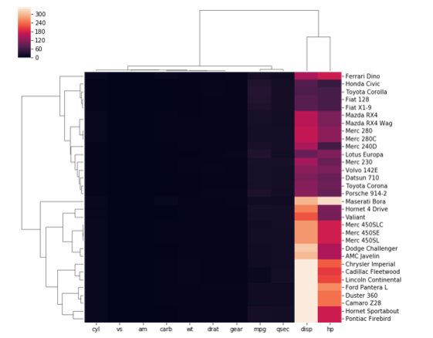
# use the outlier detection
sns.clustermap(df, robust=True) , robust=False)

